Slide 1
AVL Tree
Tree Data Structure

Slide 2
AVL Tree
An AVL tree is a self-balancing binary search tree named after its inventors Adelson-Velsky and Landis.
In an AVL tree, the heights of the two child subtrees of any node differ by at most one, ensuring that the tree remains balanced.
This balancing property helps in maintaining efficient search and insertion operations, ensuring that the tree's height remains logarithmic.

Slide 3
Key properties of AVL trees
Binary Search Tree (BST): Like regular binary search trees, AVL trees follow the BST property where each node has at most two child nodes, and the left child is less than the parent, while the right child is greater.
Balancing Factor: The balancing factor of a node in an AVL tree is the difference between the heights of its left and right subtrees. The balancing factor must be -1, 0, or 1 for every node.

Slide 4
Key properties of AVL trees
Balancing Operations: When an insertion or deletion operation disturbs the balance of the tree, rotations (single or double) are performed to restore balance. These rotations maintain the AVL tree properties.
Logarithmic Height: Due to the balancing factor restrictions, the height of the AVL tree remains logarithmic (O(log n)), ensuring efficient search and insertion times.

Slide 5
Importance
In a very simple way, the importance of AVL trees lies in their ability to keep things balanced. Imagine a phone book where names are arranged alphabetically.
An AVL tree is like organizing the names so that finding a name is quick and easy, ensuring the pages don't get too lopsided or unbalanced. This balance helps maintain efficient searching, making AVL trees valuable in applications where you want to quickly find or insert data

Slide 6
Operations of AVL tree
Insertion: When adding a node, the tree may rotate in one of four ways to maintain balance:
Left Rotation: If a node is added into the right subtree of the right subtree, a single left rotation is performed.
Right Rotation: If a node is added to the left subtree of the left subtree, a single right rotation is done.
Left-Right Rotation: A combination of left and right rotations.
Right-Left Rotation: A combination of right and left rotations.

Slide 7
Operations of AVL tree
Deletion: Deleting a node.
Searching: Searching a specific node

Slide 8
Advantages
Self-balancing: AVL trees automatically maintain balance.
Not skewed: Unlike some other trees, AVL trees avoid extreme height differences.
Faster lookups: Better searching time complexity compared to binary trees.
Height constraint: The height cannot exceed log(N), where N is the total number of nodes.

Slide 9
Disadvantages
Implementation complexity.
Higher constant factors for some operations.
Less commonly used compared to Red-Black trees.
More rotations during insertion and removal due to strict balance.

Slide 10
Applications of AVL trees
AVL trees find applications in:
indexing large databases
in-memory collections
optimized search algorithms
corporate systems and storyline games.
They strike a balance between maintaining balance and efficient operations.

Slide 11
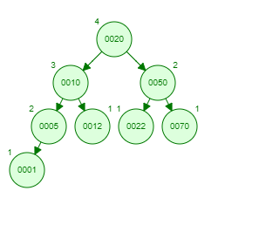
Example

Slide 12
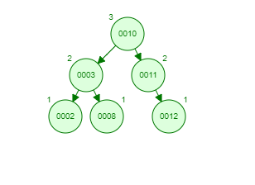
Example

